Slide 1
IHEP SUSY Group Meeting
Chengxin Liao
Institute of High Energy Physics Chinese Academy of Sciences Jul 23, 2025

Slide 2
C1N2 Status
Split run2 and run3 then Update Bkg estimation(Done)
Update support-note(Ongoing) Note: lowerpad for MC modeling label have typo(bkg/MC, it should be bkg/Data)

Slide 3
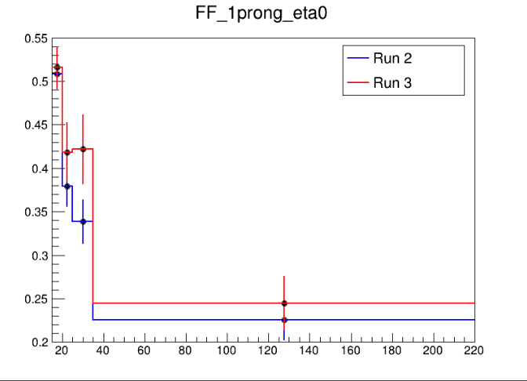
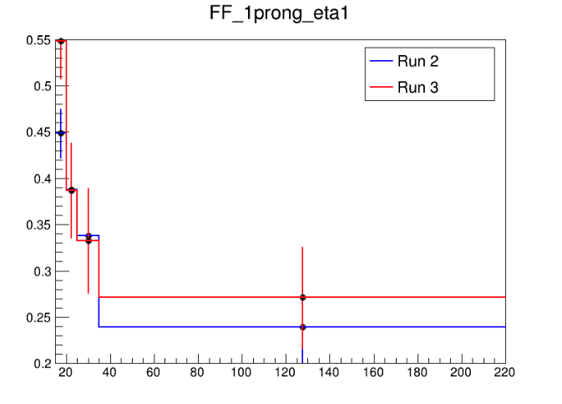
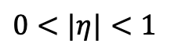
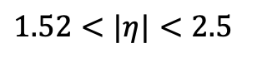
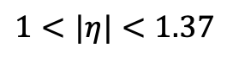
Fake Factor for Run2 and Run3
$0<|η|<1$
$1<|η|<1.37$
$1.52<|η|<2.5$
Selection:
nBaseTau == 1
nBaseLep >= 1, SigLep >= 1 MET trigger, MET >= 200
Same-Signal(Orthogonal with SR) bVeto ID: nMediumTau == 1 antiID: nMediumTau < 1
A small bump show in the last bin

Slide 4
Pre-Selection
HH Pre-selection
>= 2 medium taus
0 base lepton
MET ≥ 200; pass MET trigger
1≤nJet
Opposite-sign hadronic-hadronic tau pair
bveto
jet pt>100 GeV
Mtt_reco <= 40 GeV || Mtt_reco >= 130GeV
LH Pre-selection
>= 1 medium taus
1 base lepton, 1 signal lepton
MET ≥ 200; pass MET trigger
1≤nJet
Opposite-sign lepton-hadronic tau pair
bveto
jet pt>100 GeV
Mtt_reco <= 40 GeV || Mtt_reco >= 130GeV

Slide 5
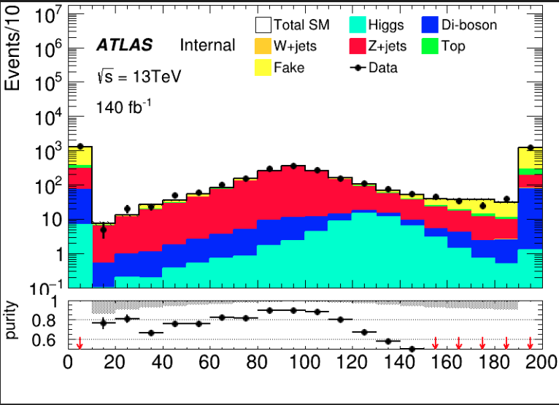
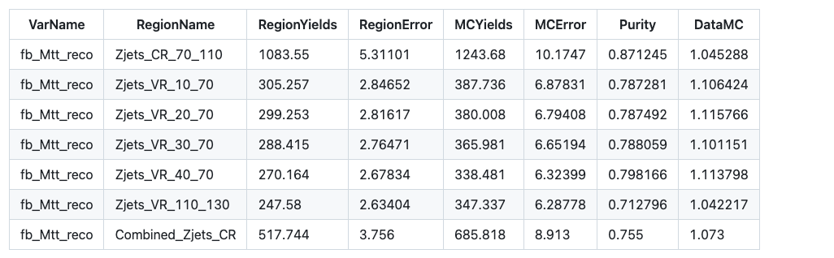
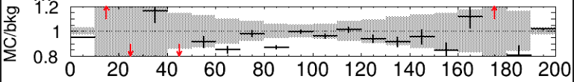
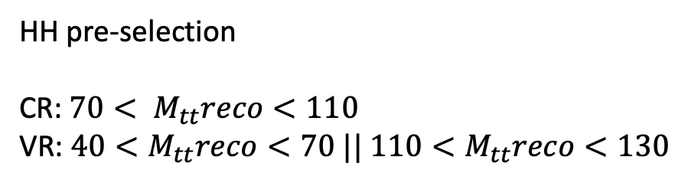
HH channel: Z bkg estimation(run2)
HH pre-selection CR: $70< M_{tt}reco<110$ VR: $40<M_{tt}reco<70 || 110<M_{tt}reco<130$
To Orthogonal with pre-selection, lower cut must in 40 or we need to change pSR

Slide 6
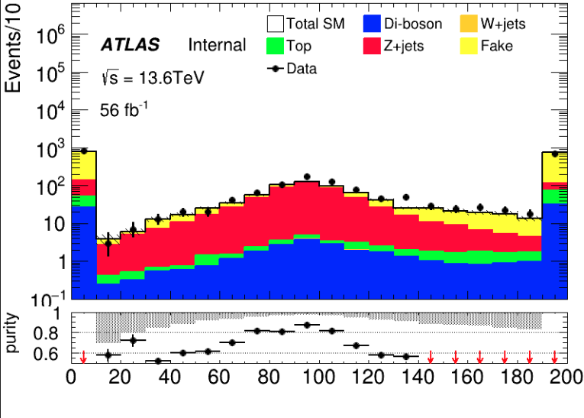
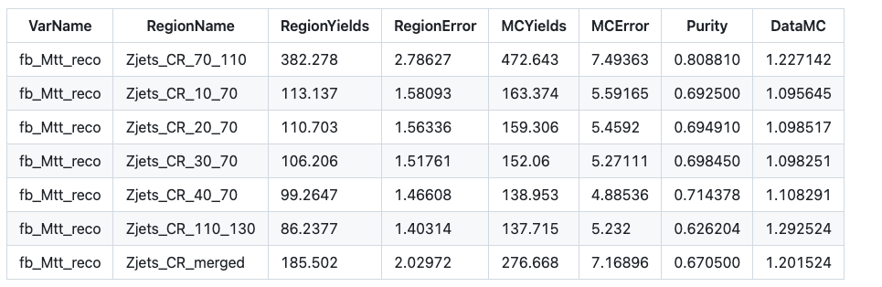
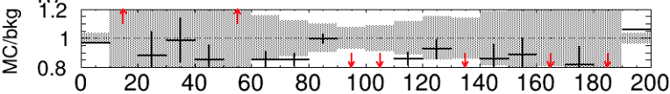
HH channel: Z bkg estimation(run3)
HH pre-selection CR: $70< M_{tt}reco<110$ VR: $40<M_{tt}reco<70 || 110<M_{tt}reco<130$
To Orthogonal with pre-selection, lower cut must at 40 or we need to change pSR

Slide 7
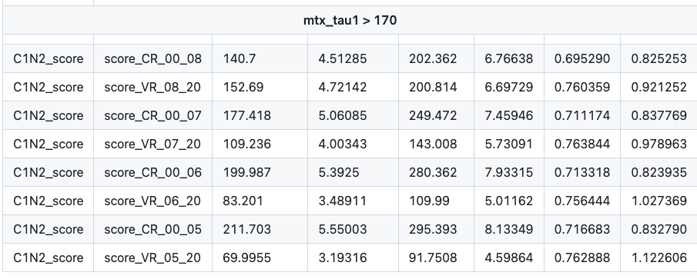
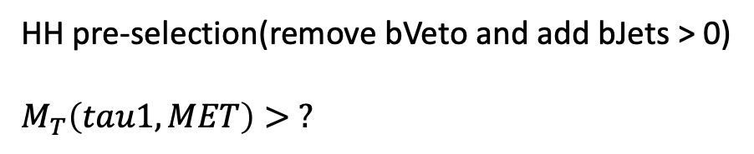
HH channel: Top bkg estimation(run2)
HH pre-selection(remove bVeto and add bJets > 0)
$$M_{T}\left(tau1, MET\right)> ?$$
CR: C1N2 score < ? VR: ? < C1N2 score
map
[-1,1]->[0,20]
Cut set: 170, 180, 190, 200; C1N2 score cut: -0.8, -0.7, -0.6, -0.5
Notes:
Top_CR: 123.241, Error: 4.22913
Top_VR: 103.166, Error: 3.89985
, MC_CR: 168.225, Error: 6.00345
, MC_VR: 131.66, Error: 5.39455
, purity_CR: 0.732596
, purity_VR: 0.783579
Data_CR:137
Data_VR:120, SF:0.817986

Slide 8
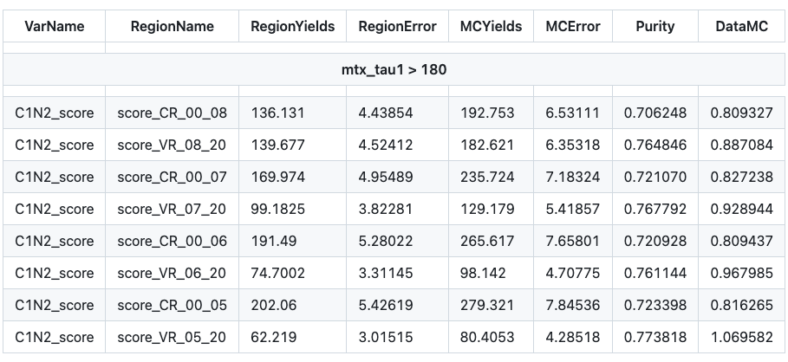
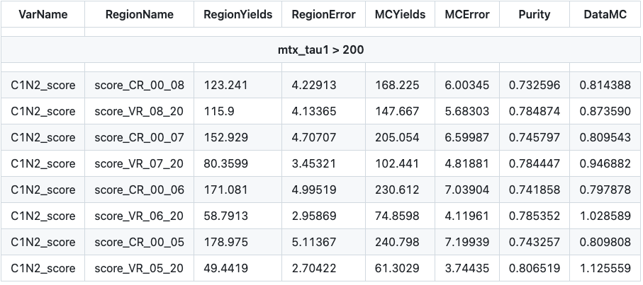
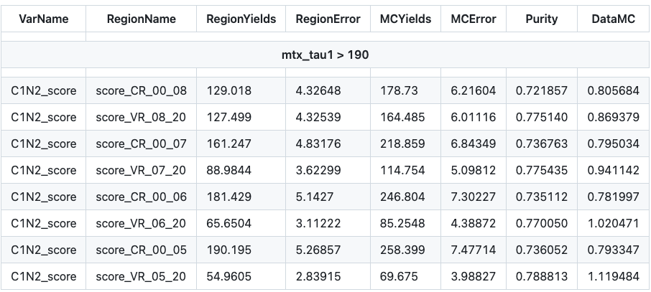
HH channel: Top bkg estimation(run2)
Notes:
Top_CR: 123.241, Error: 4.22913
Top_VR: 103.166, Error: 3.89985
, MC_CR: 168.225, Error: 6.00345
, MC_VR: 131.66, Error: 5.39455
, purity_CR: 0.732596
, purity_VR: 0.783579
Data_CR:137
Data_VR:120, SF:0.817986

Slide 9
HH channel: Top bkg estimation(run2)
Best cut combination
mt cut > 170
mt cut > 180
mt cut > 190
mt cut > 200
Notes:
Top_CR: 123.241, Error: 4.22913
Top_VR: 103.166, Error: 3.89985
, MC_CR: 168.225, Error: 6.00345
, MC_VR: 131.66, Error: 5.39455
, purity_CR: 0.732596
, purity_VR: 0.783579
Data_CR:137
Data_VR:120, SF:0.817986

Slide 10
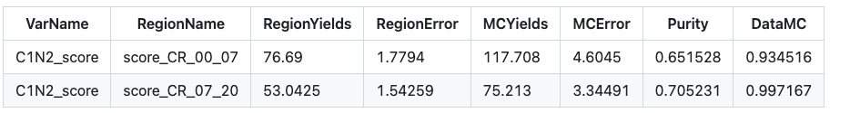
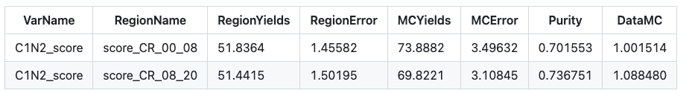
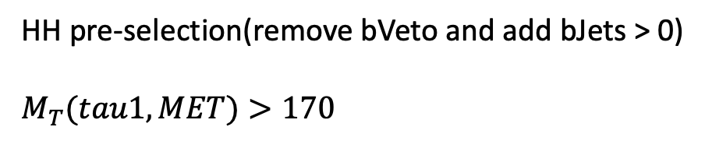
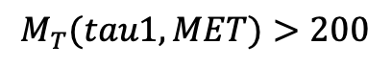
HH channel: Top bkg estimation(run3)
HH pre-selection(remove bVeto and add bJets > 0)
$$M_{T}(tau1, MET)>170$$
CR: C1N2 score < -0.7 VR: -0.7 < C1N2 score
Keep consistant with run2 selection
Old version
CR: C1N2 score < -0.8 VR: -0.8 < C1N2 score
$$M_{T}(tau1, MET)>200$$
Notes:
Top_CR: 51.8364, Error: 1.45582
Top_VR: 51.0968, Error: 1.49776
, MC_CR: 73.8882, Error: 3.49632
, MC_VR: 69.4798, Error: 3.10636
, purity_CR: 0.701553
, purity_VR: 0.73542
Data_CR:74
Data_VR:75, SF:1.03281

Slide 11
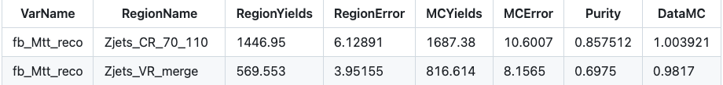
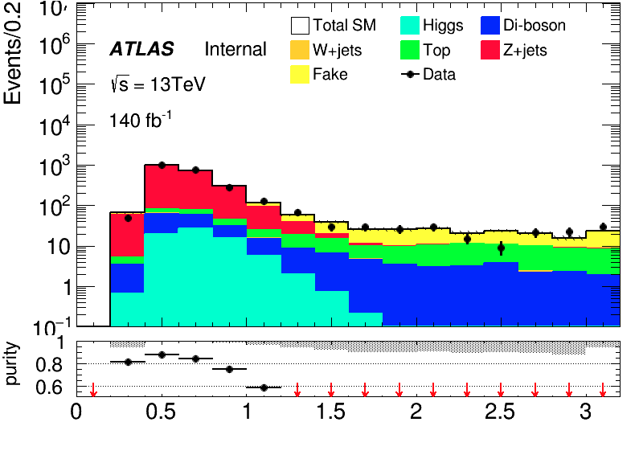
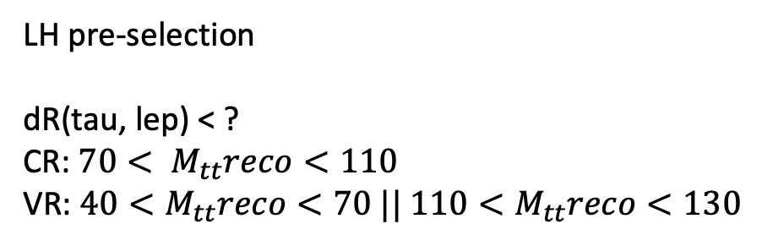
LH channel: Z bkg estimation(run2)
LH pre-selection
dR(tau, lep) < ? CR: $70< M_{tt}reco<110$ VR: $40<M_{tt}reco<70 || 110<M_{tt}reco<130$
Only add 10 < Mtt reco < 130
dRtt < 1.5
dRtt < 1.2
dRtt < 1.0
dRtt < 0.8
dRtt < 0.6
Notes:
Zjets_CR: 602.218, Error: 3.57613
Zjets_VR1: 275.731, Error: 2.43721
Zjets_VR2: 62.982, Error: 1.07491
, MC_CR: 660.681, Error: 5.86854
, MC_VR1: 316.96, Error: 4.18877
, MC_VR2: 92.6616, Error: 1.94987
, purity_CR: 0.911511
, purity_VR1: 0.869922
, purity_VR2: 0.679699 Data_CR:625Data_VR1:349Data_VR2:85

Slide 12
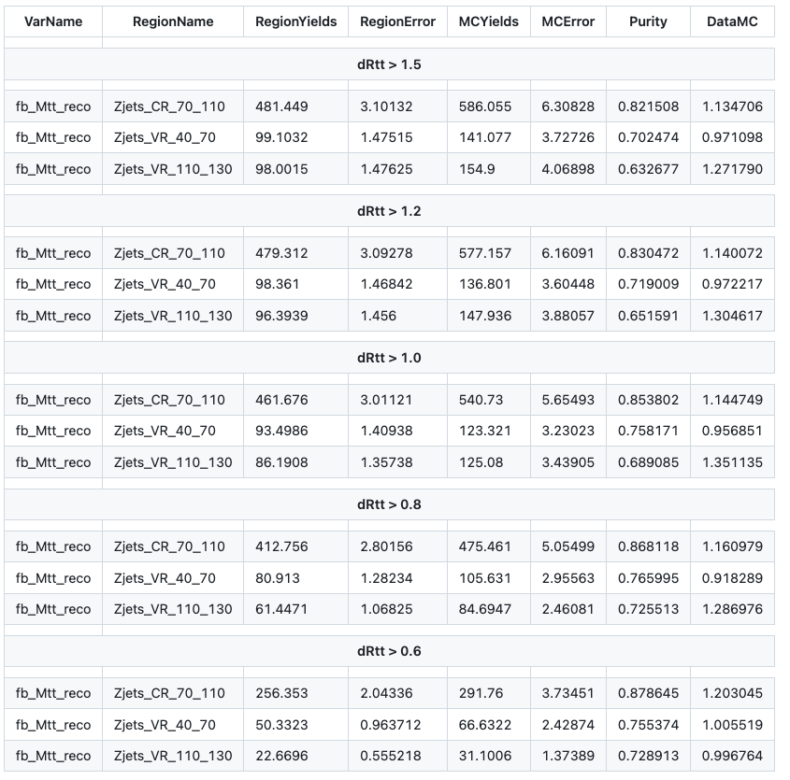
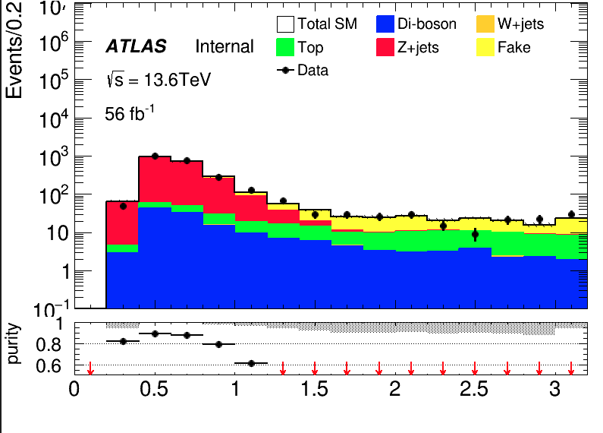
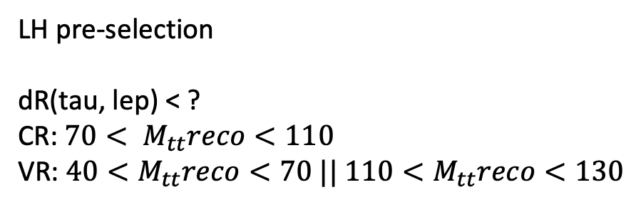
LH channel: Z bkg estimation(run3)
LH pre-selection
dR(tau, lep) < ? CR: $70< M_{tt}reco<110$ VR: $40<M_{tt}reco<70 || 110<M_{tt}reco<130$
Only add 10 < Mtt reco < 130
Caused by low statistic ?
Notes:
Zjets_CR: 202.29, Error: 1.79532
Zjets_VR1: 96.3843, Error: 1.31294
Zjets_VR2: 21.0604, Error: 0.527863
, MC_CR: 230.559, Error: 3.31619
, MC_VR1: 118.019, Error: 2.82184
, MC_VR2: 29.0431, Error: 1.34237
, purity_CR: 0.877391
, purity_VR1: 0.816687
, purity_VR2: 0.725144
Data_CR:277Data_VR1:127Data_VR2:29

Slide 13
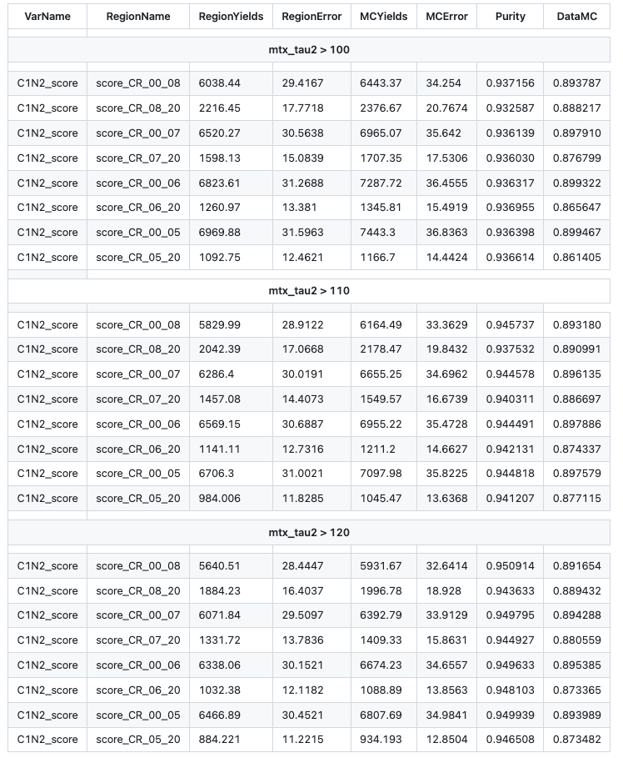
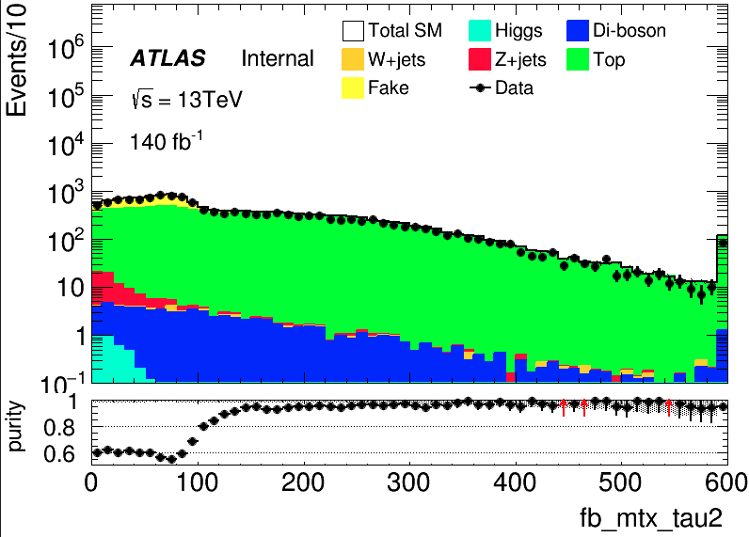
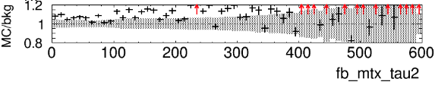
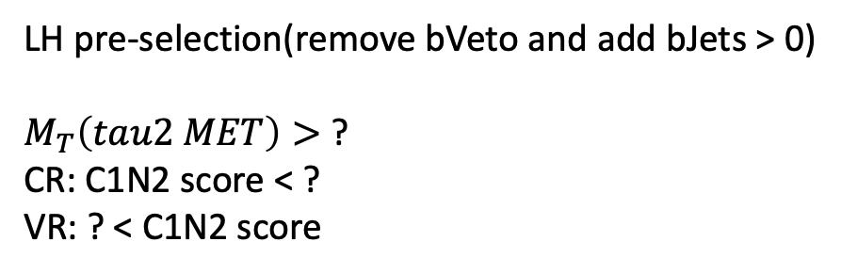
LH channel: Top bkg estimation(run2)
LH pre-selection(remove bVeto and add bJets > 0) $M_{T}\left(tau2 MET\right)>$ ?
CR: C1N2 score < ? VR: ? < C1N2 score
10% disagreement in raw distribution
Notes:
../run2/LHTCR_merged_run2/5fold/C1N2_weight/final
Top_CR: 2743.2, Error: 19.9115
Top_VR: 559.551, Error: 8.9529
, MC_CR: 2981.65, Error: 23.4706
, MC_VR: 619.636, Error: 10.6324
, purity_CR: 0.920027
, purity_VR: 0.903032
Data_CR:2593
Data_VR:565, SF:0.864075

Slide 14
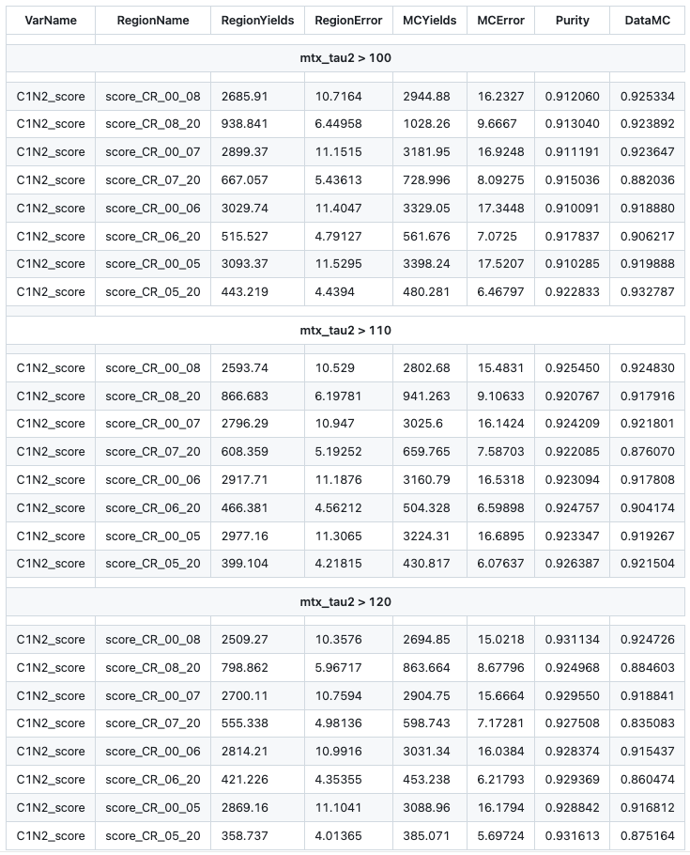
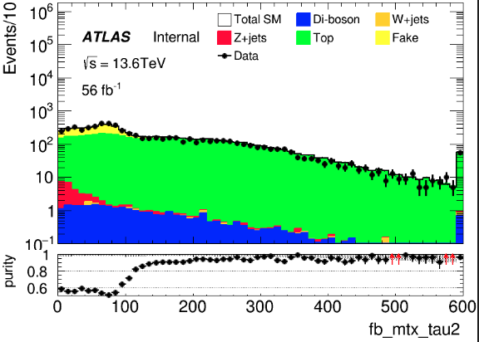
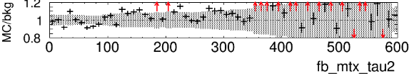
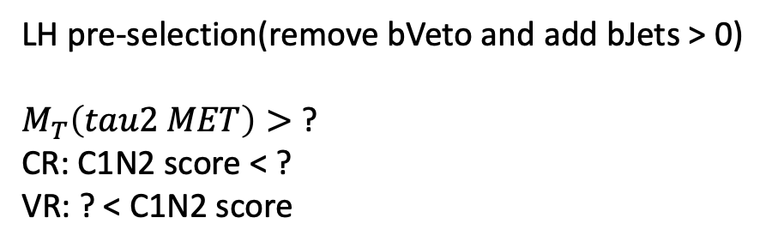
LH channel: Top bkg estimation(run3)
LH pre-selection(remove bVeto and add bJets > 0) $M_{T}\left(tau2 MET\right)>$ ?
CR: C1N2 score < ? VR: ? < C1N2 score
Notes:
Top_CR: 1295.59, Error: 7.50495
Top_VR: 288.832, Error: 3.70686
, MC_CR: 1446.25, Error: 11.5498
, MC_VR: 314.054, Error: 5.23929
, purity_CR: 0.895826
, purity_VR: 0.919688
Data_CR:1278
Data_VR:298, SF:0.883374

Slide 15
Backup

Slide 16
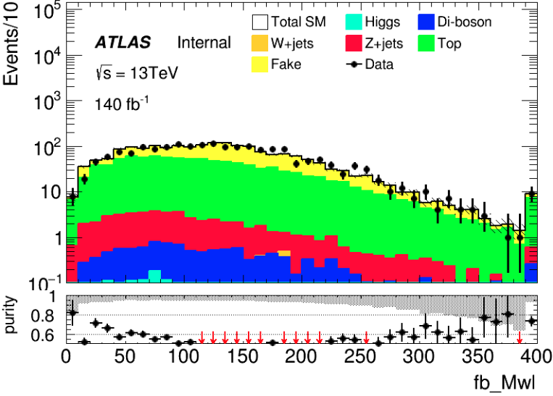
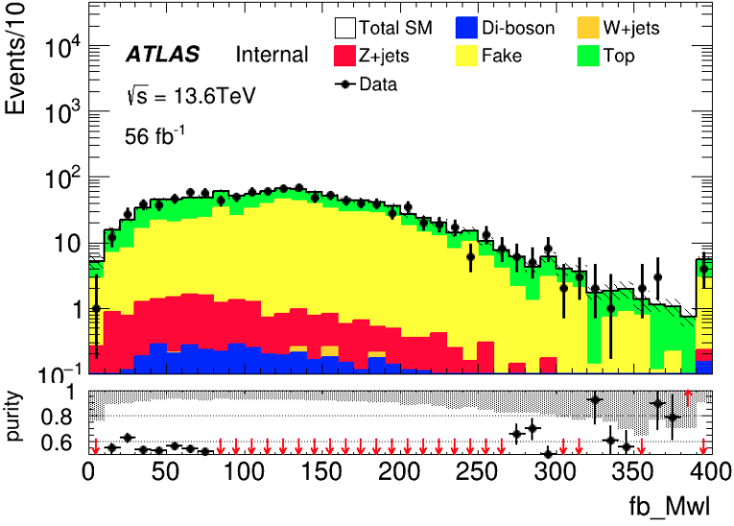
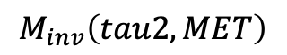
Distribution Check
LH Channel
HH TCR run2
HH TCR run3
Change Mtt_reco to [10,130]
run2
run3
LH channel
$$M_{inv}\left(tau2, MET\right)$$
run2
run3

Slide 17
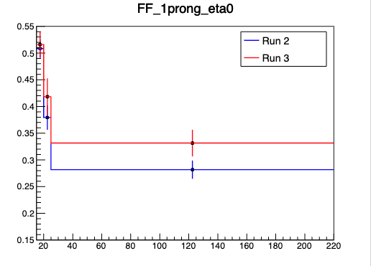
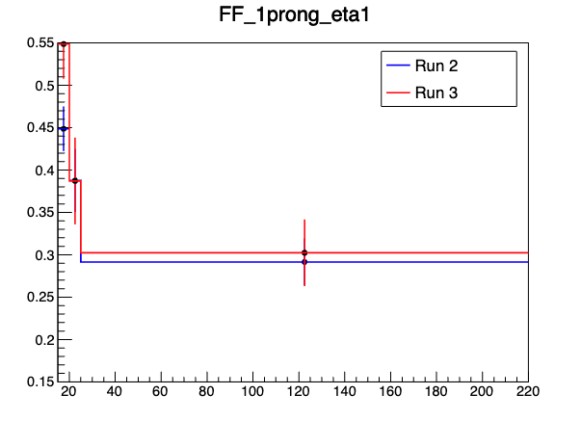
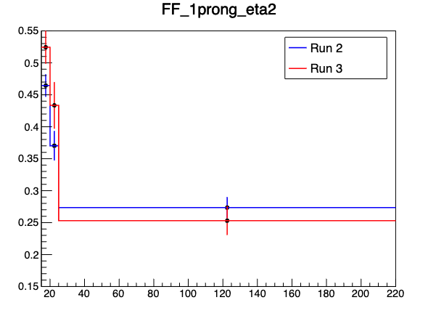
Cross-Check FF
$0<|η|<1$
$1<|η|<1.37$
$1.52<|η|<2.5$
My result
Wenyi’s result
Same value for first two bins and different in last bin for different rebin strategy I check FF with same rebin method in case, it turns out we are the same

Slide 18
Fake Factor for Run2 and Run3
$0<|η|<1$
$1<|η|<1.37$
$1.52<|η|<2.5$
Selection:
nBaseTau == 1
nBaseLep >= 1, SigLep >= 1 MET trigger, MET >= 200
Same-Signal(Orthogonal with SR) bVeto ID: nMediumTau == 1 antiID: nMediumTau < 1
A small bump show in the last bin

Slide 19
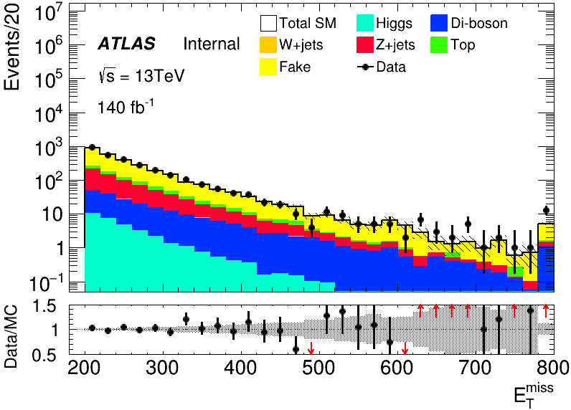
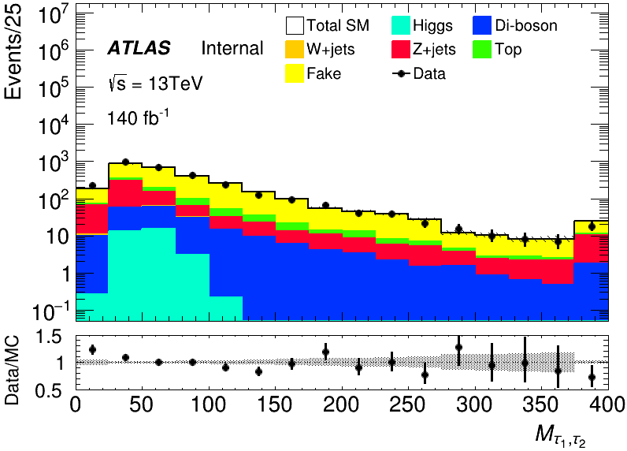
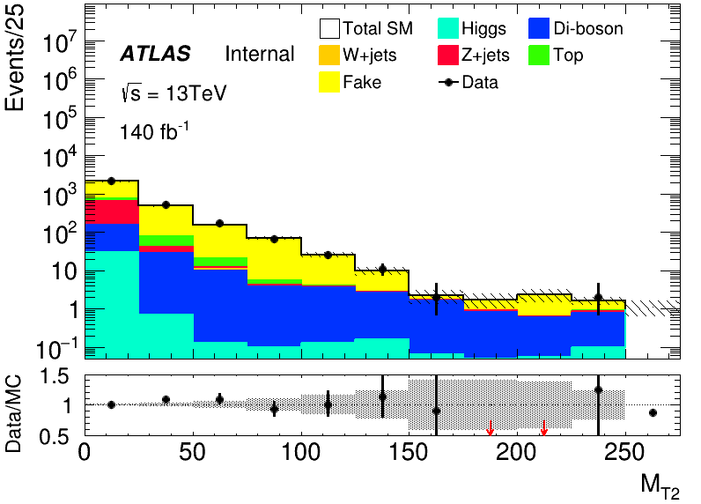
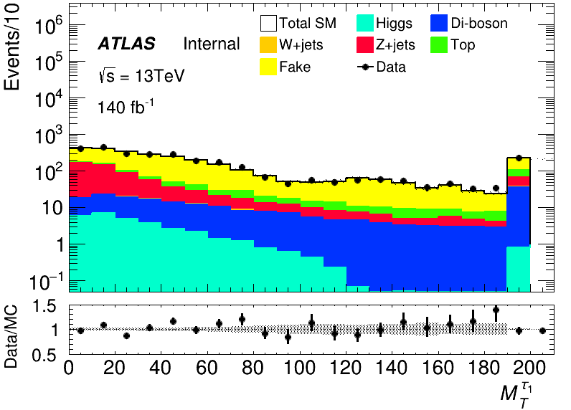
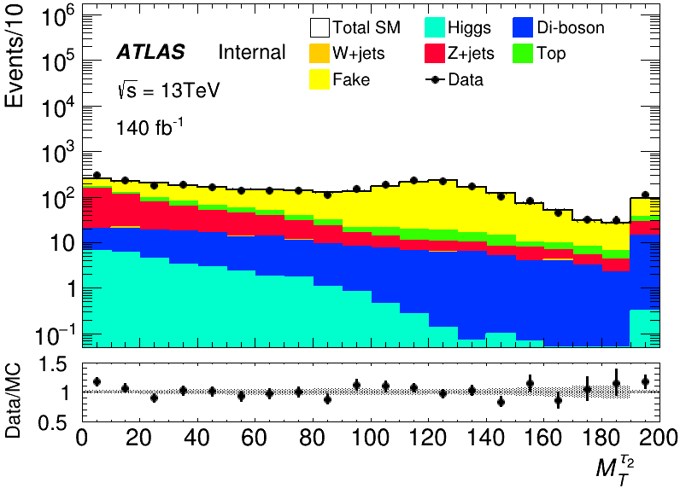
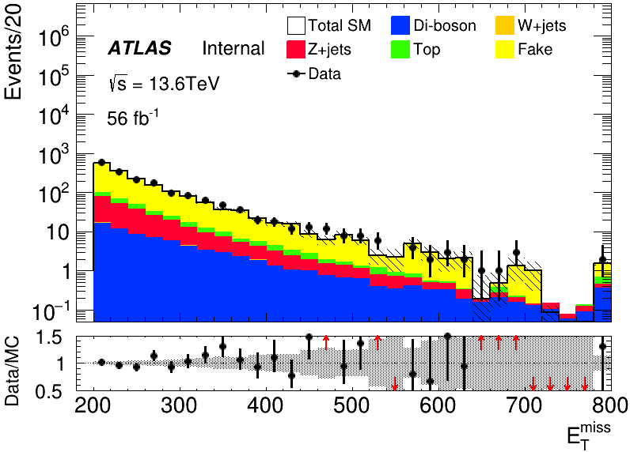
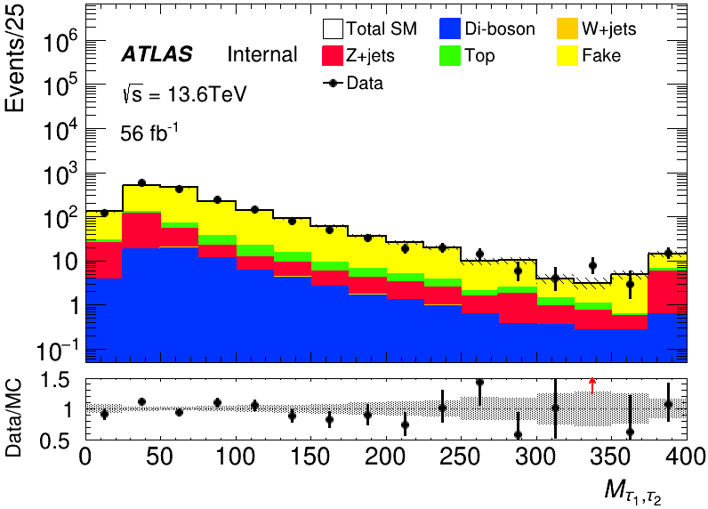
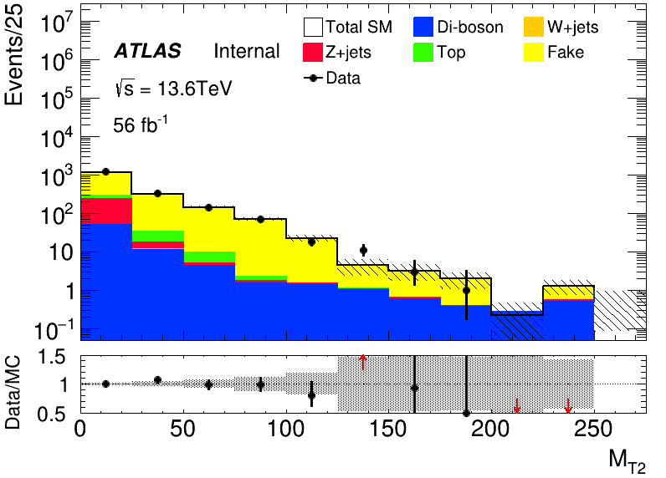
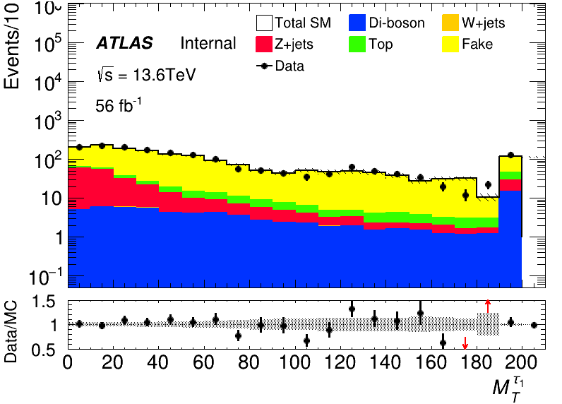

MC modeling in Pre-Selection(HH)
run2
run3

Slide 20








MC modeling in Pre-Selection(HH)
run2
run3

Slide 21






MC modeling in Pre-Selection(HH)
run2
run3

Slide 22










MC modeling in Pre-Selection(LH)
run2
run3

Slide 23








MC modeling in Pre-Selection(LH)
run2
run3

Slide 24






MC modeling in Pre-Selection(LH)
run2
run3

Slide 25
C1N2 SR(HH and LH)
Input sample:
bkg: run2 bkg sample passed pre-selection(HH/LH) sig: 100_70, 120_90, 140_90(only run2)
Hyperparameters: HH: Ntrees = 300, MaxDepth = 6, MinNodeSize = 1%, Learning rate = 0.05
LH: Ntrees = 200, MaxDepth = 6, MinNodeSize = 1%, Learning rate = 0.05
Weight choose: abs(physics weight)
Split strategy: Separate entries by using mod 5, for Fake bkg, if separate follow sequence, all weighted entry will split into first fold

Slide 26




BDT distribution for LH and HH
HH
LH
run2
run3

